Slide 1
First beta user survey
70 Responders
Presented by Patrick Clarkin

Slide 2
About the User

Slide 3
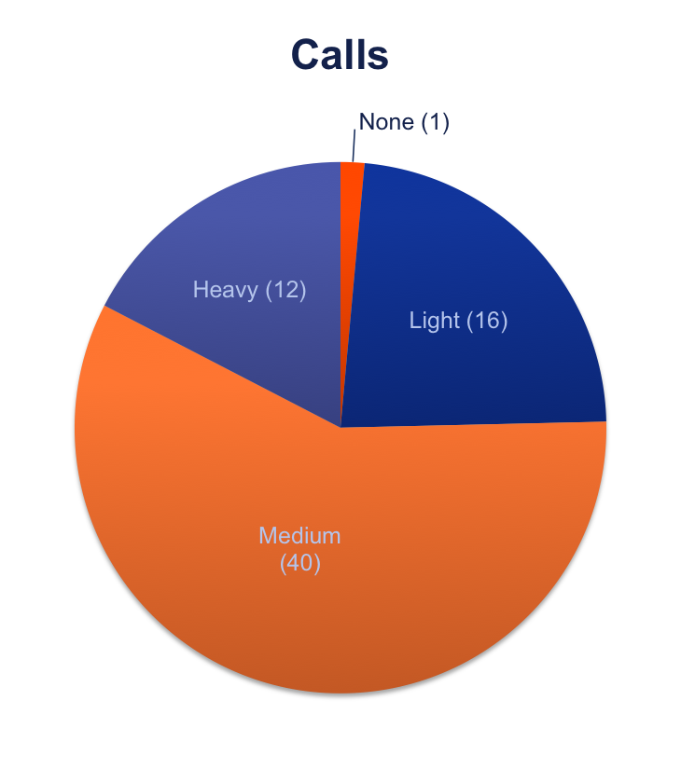
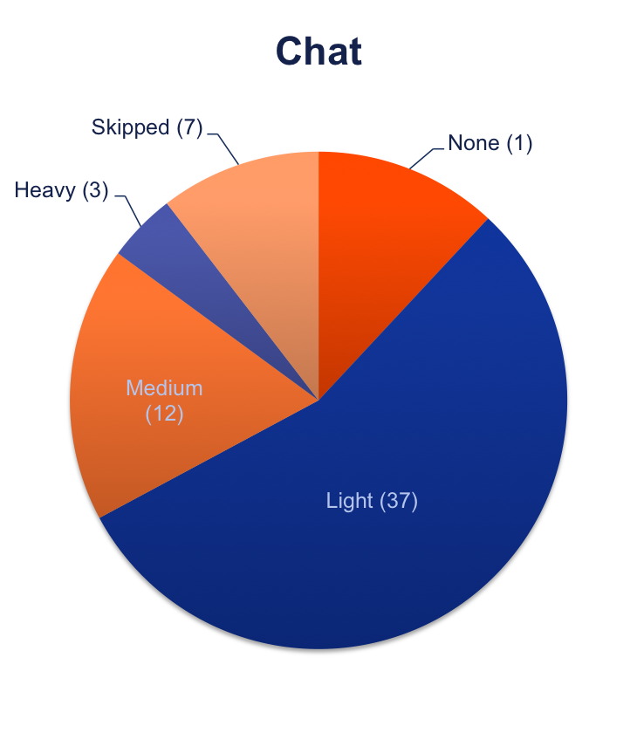
What type of user are you?

Slide 4
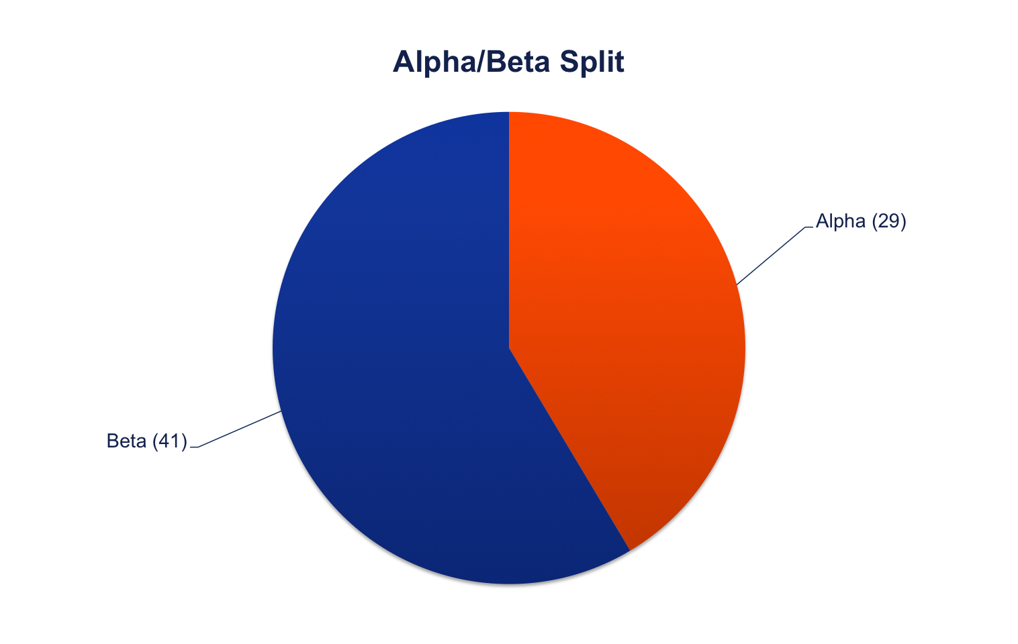
Were you an alpha user?

Slide 5
Client usage

Slide 6
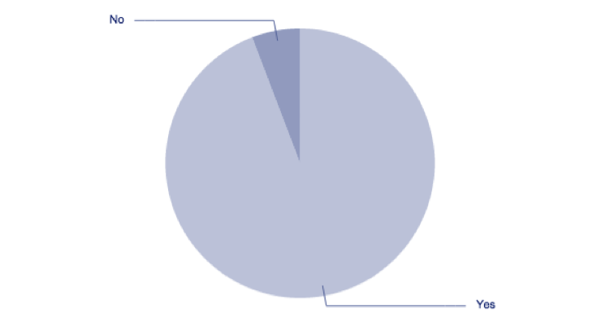
Did you install the latest Client?
The NO’s:
Known issue with 3-way calls; I'm waiting to see that fixed first
I mainly use my deskphone rather than the soft client
Visiting customers, not had chance to try out the new version yet.
(Haven't had time yet! hesitent to waste my time on it because I know absolutely nothing I provide as feedback will have any impact on the product.)

Slide 7
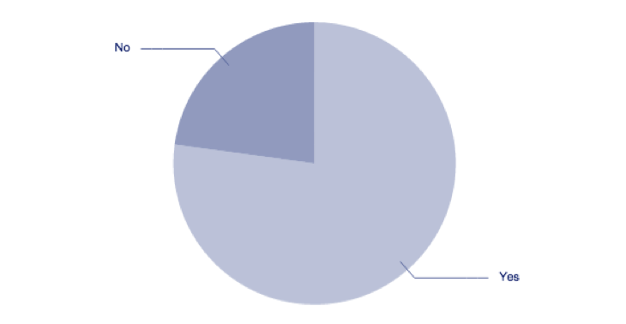
Are you still using Accession Desktop?
The NO’s:
Call quality
Two calls of completely terrible quality, so I uninstalled it.
Occasional one-way / terrible audio.
Problems with call quality
Voice quality issues (reported)
Had 3 or 4 calls with very poor quality, and went back to CPC
Media bad on some calls, PC speaker doesn't ring, so I miss the fact I'm being called.
Media problems make it unusable for me
I've still got it installed, but I had to fall back to CPC Desktop yesterday because the call quality was too jittery on Accession.
Device Selection
I can't get it to register audio from my microphone, so have reverted to using CPC until we can figure out why.
Could not get headset to work (known bug but suggestion to restart client doesn't help)
Others
As secondary Phone
I prefer CPC
Use a desktop phone'; have install accession in case need to troubleshoot user issues or work from home
Mac OSX won't let me start the app

Slide 8
Users who were previously using CPC-D

Slide 9
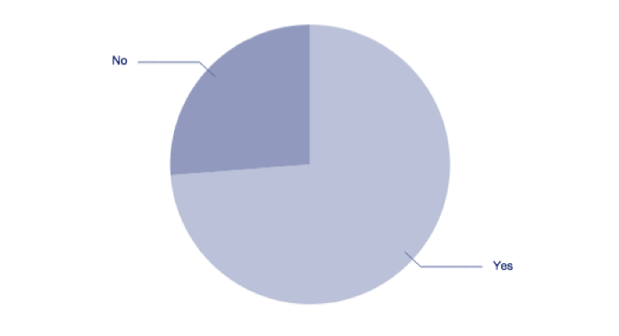
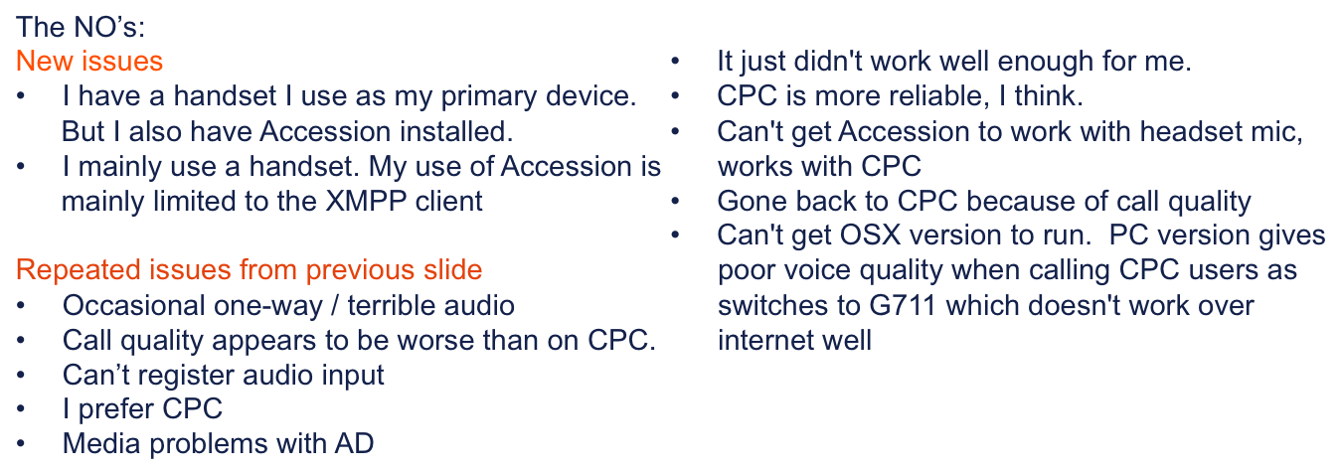
Are you using AD as a replacement to cpc-d?

Slide 10
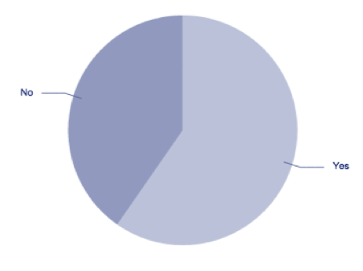
Do you think its an adequate replacement?
The NO’s:
Call quality
Occasional one-way / terrible audio
Call quality.
Can't get it to send audio
Audio drop-outs
Audio quality on vast majority of calls is dreadful
Call quality issues. Dropped calls. Codec negotiation issues. (Probably Perimeta's fault).
Poor audio quality in lots of circumstances where CPC was fine.
My outgoing audio quality is poor and I used LSM a lot.
I'm getting more call quality issues than I did with CPC, particularly to PSTN.
Missing features
The 3-way calling limitation is stopping me
3-way calling doesn't work yet!
Needs easier way to find people to call
Contacts don't work properly yet, plus there are a few other features missing
Lacking in features that I see in CPC
Still confused over user states and contact management. Various other bugs.
Poor general impression
The interface isn't as intuitive
CPC was bad enough, with the additional limitations of Accession Desktop, I really pine for days gone by when I had a phone on my desk.
Neither is good enough as a replacement for the old phone system.
It generally doesn't work as well just yet.
Usability and bugs to work through first!
UI still looks clunky by comparison
Is it as good as CPC-D: yes. Is it adequate as a user's primary phone: no.

Slide 11
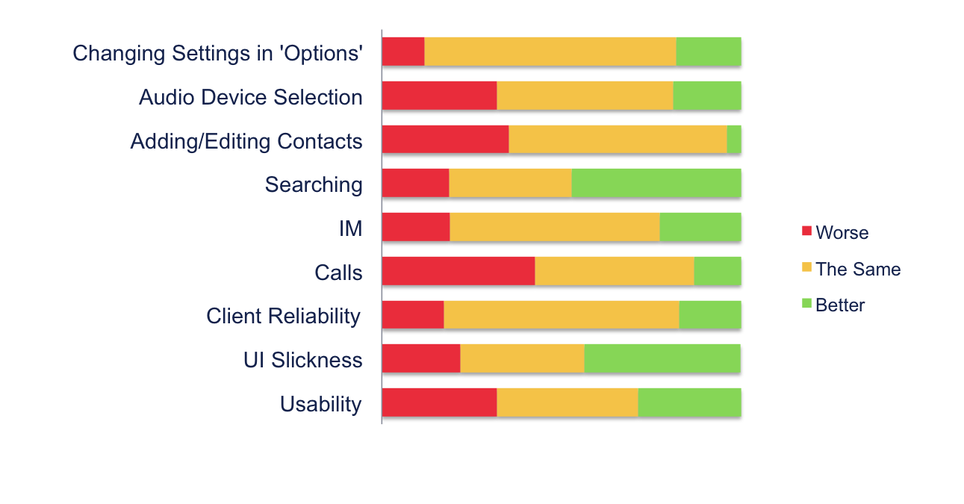
How does AD rate against CPC-D?
As you can see, in all cases over 50% of users rated AD the same or better than CPC-D. There were also lots of pieces of feedback which I’ve fed into the UI/X bugs on Gdocs.

Slide 12
Accession desktop Quality

Slide 13
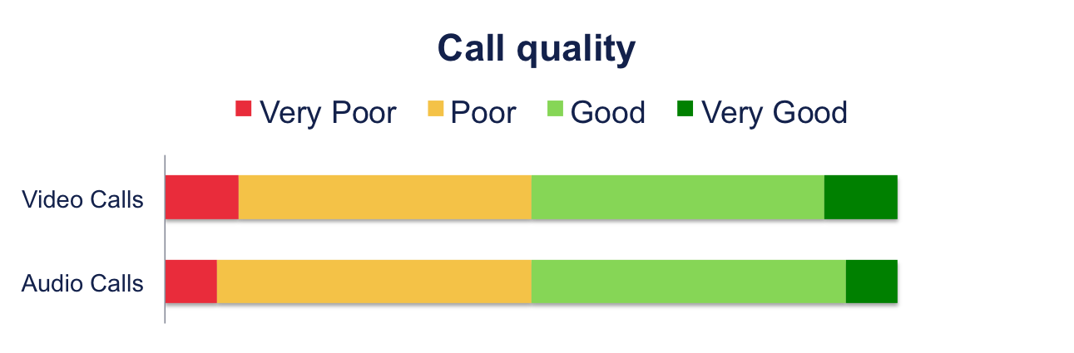
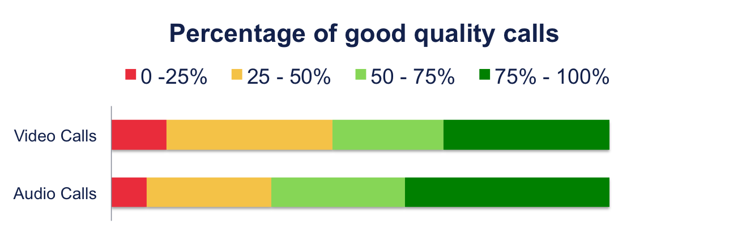
Call quality & Reliability
Caveat: Only 10 users actually tested video calling

Slide 14
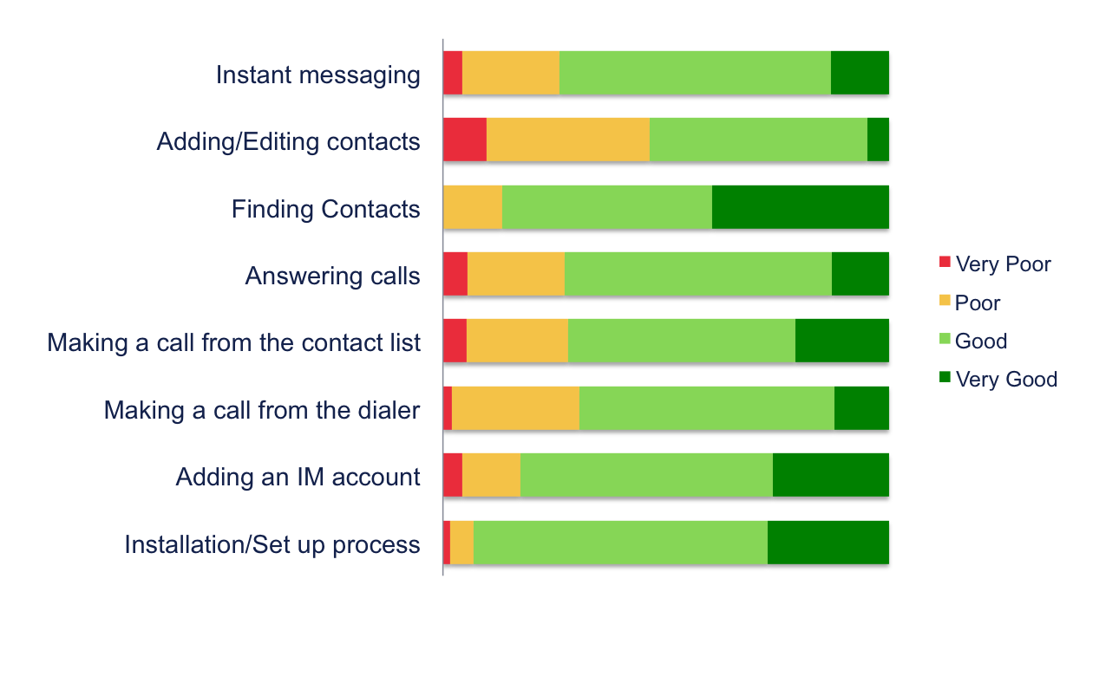
How Do you rate the following features in terms of Usability?

Slide 15
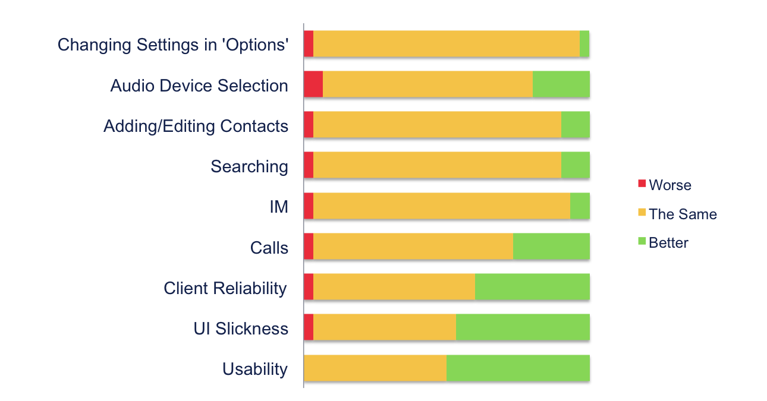
How Do you rate the following compared to the previous alpha release?

Slide 16
New features

Slide 17
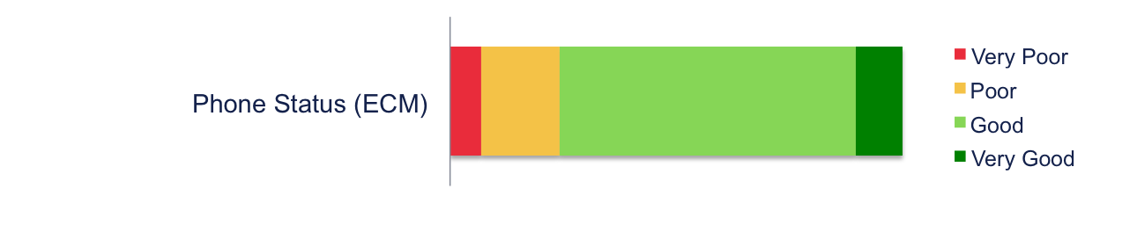
How Do you rate the following New features?
Feedback:
I can only set 1 of 3 ECM states, but call state (IM state?) can be "on the phone"? Broken paradigm.
I don't use ECM. Until ICM support, this doesn't help me.
Don't know what this is
Looks good, though I've not used this at all!
Unreliable: sometimes it appears, sometimes does not appear.
What's ECM?
Big green button with a telephone no it usually means "place call"
Not sure what this actually is
No support for custom statuses
There's a line through the heading in the drop down, and the drop down mis-aligned
The term ECM is never used on the client.
There is clearly confusion as to what this button does/whether its ECM or IM status. It’s something I’d like to look at this sprint.

Slide 18
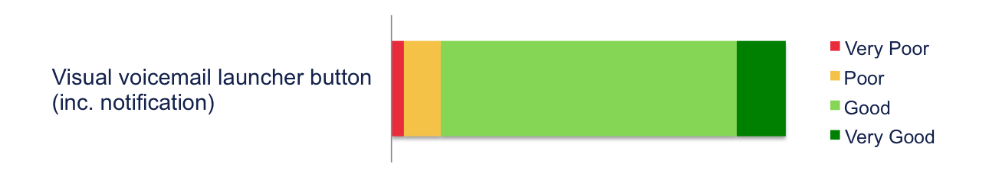
How Do you rate the following New features?
Feedback:
But why do I need to log into CommPortal Web?
Should be in app, not launching a new web window
Kind of slow to get going.
Indication fails to clear after deleting VM
Didn't know feature existed!
Slow to load though
I'd like to get my voicemail in-app. That would allow selection of audio-playback device.
Buttons on top panel are inconsistent in shape

Slide 19

How Do you rate the following New features?
Feedback:
Support generally is fine, but the UI once into an IM session is relatively underdeveloped / slightly clunky
I frequently undock my computer losing the network connection. I then get a popup saying "Jabber authentication failed" and have to re log in. a) why can't it log in for me? b) authentication didn't fail so the message is misleading
need to display contact's state
Looks like 3270 screen (type face, unfriendly email addresses), does not show current presence on window, bottom left icon seems to have little benefit (have I missed a feature it should offer?)
No presence

Slide 20
Patrick Clarkin
06/02/13

